Slide 1
School of Geography and Earth Science McMaster University
Advanced Topics in Spatial Statistics
Spatially Continuous Data
III & IV

Slide 2
This session:
Spatially Continuous Data
  Exploration: Second Order Properties
    Covariogram, correlogram and variogram
  Modeling spatially continuous data
    Trend surface analysis

Slide 3
Spatially continuous data:
Visualization of first order effects
Visualization
  Symbol maps
  Indicator maps
  Grayscale maps
  Proportional symbol maps
  Colors
  …

Slide 4
Spatially continuous data:
Exploration of first order effects
Exploration
  Moving averages
  Kernel estimation
  Tesselations
    Gradient maps
    Contour maps

Slide 5
Second order effects:
Smaller scale variation
Point patterns
  Nearest-neighbor distance analysis
Spatially continuous data
  Covariation of neighboring observations

Slide 6
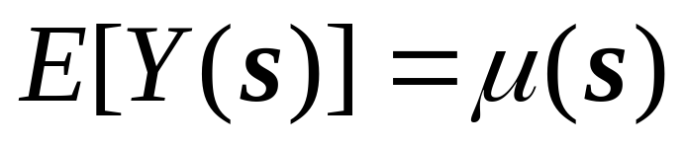
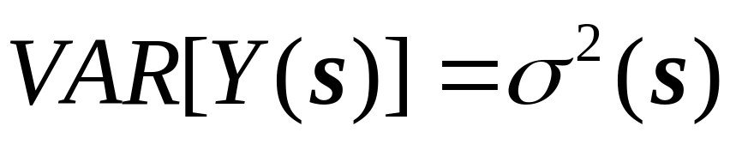
Definitions
Mean and variance of a spatial random variable

Slide 7


Mean and variance in a stationary process

Slide 8








Mean and variance of a spatial random variable

Slide 9
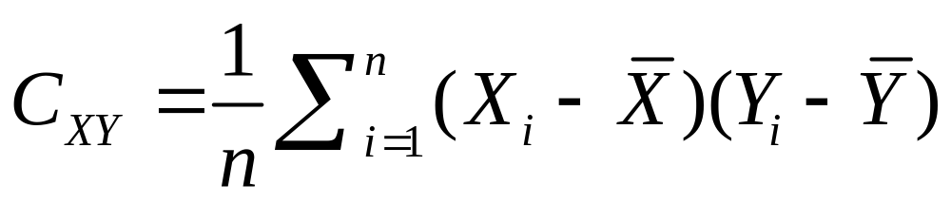
Covariance (two variables)
Covariance

Slide 10


Covariance (two variables)
Covariance

Slide 11
Covariance (two variables)
Covariance

Slide 12
Covariance (two variables)
Covariance

Slide 13
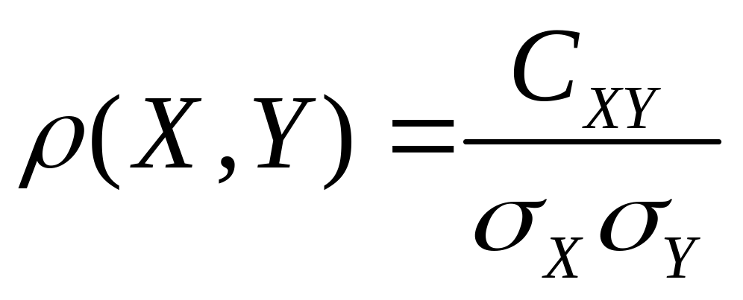
Correlation of the process
Correlation of the process between X and Y

Slide 14
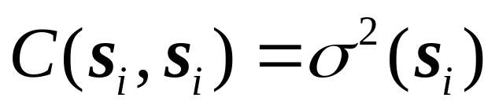
Auto-covariance of the process
Covariance of the process between s_{i} and s_{j}

Slide 15
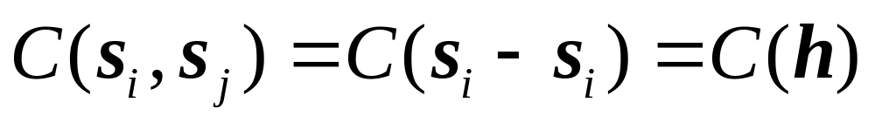
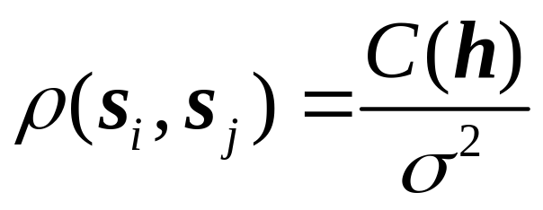
Covariance of a stationary process
Covariance of the process between s_{i} and s_{j} depends on distance and direction only
Correlation

Slide 16
Auto-covariance at various spatial lags
y₁=8 y₂=9 y₃=8 y₄=7 y₅=6 y₆=7 y₇=8 y₈=9
y=7.75
1
h=1
6
2,7
5
3
4

Slide 17
Auto-covariance at various spatial lags
y₁=8 y₂=9 y₃=8 y₄=7 y₅=6 y₆=7 y₇=8 y₈=9
y=7.75
(y1,y2)
h=1
(y6,y7)
(y2,y3)
(y7,y8)
(y5,y6)
(y3,y4)
(y4,y5)

Slide 18
Auto-covariance at various spatial lags
y₁=8 y₂=9 y₃=8 y₄=7 y₅=6 y₆=7 y₇=8 y₈=9
y=7.75
(y6,y9)
h=2
(y5,y7)
(y1,y3)
(y2,y4)
(y4,y6)
(y3,y5)

Slide 19
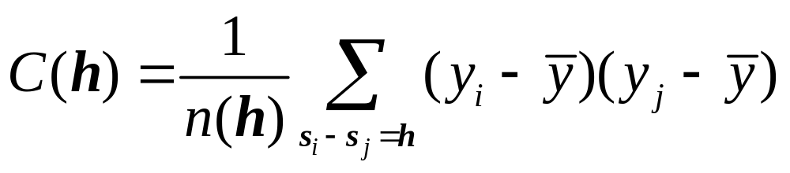
Covariogram
A plot of the covariance of the process at various spatial lags

Slide 20
Covariogram
C(0)=σ²
h

Slide 21
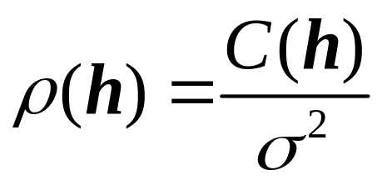
Correlogram
ρ(0)=1
h

Slide 22
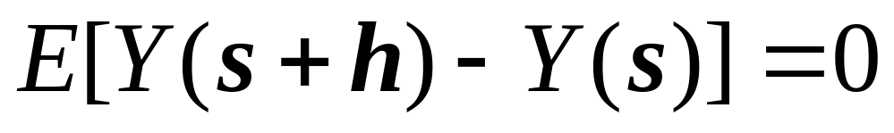
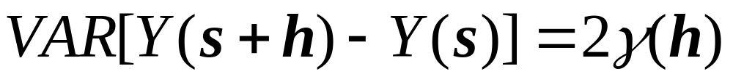
Variogram
Intrinsic stationarity (weaker assumption)

Slide 23
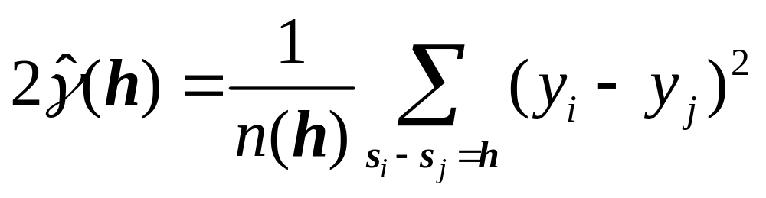
Variogram
Intrinsic stationarity

Slide 24
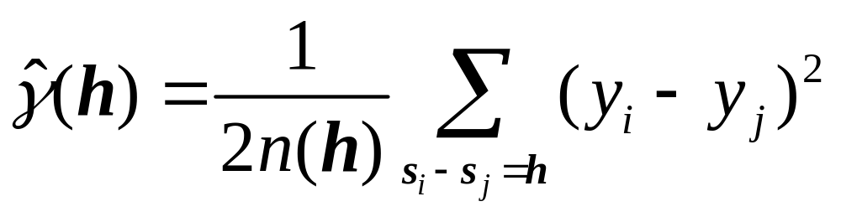

Variogram
σ²
Sill
Range
h

Slide 25
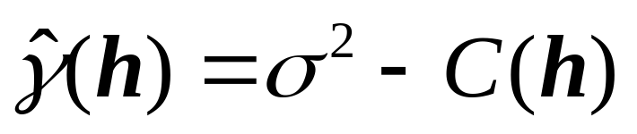
Covariogram, correlogram, variogram
Covariogram C(h)
Correlogram
C(0)=σ²
ρ(0)=1
h
h
Variogram
σ²
h

Slide 26
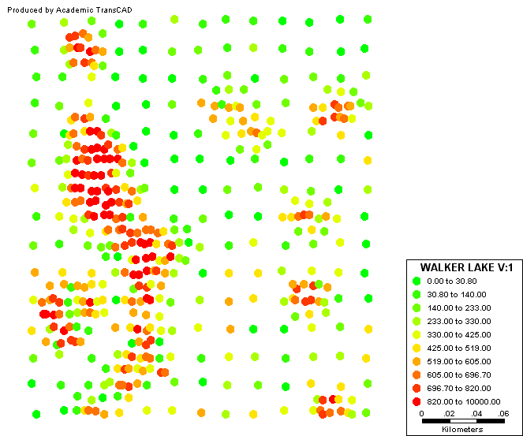
How to read the variogram

Slide 27
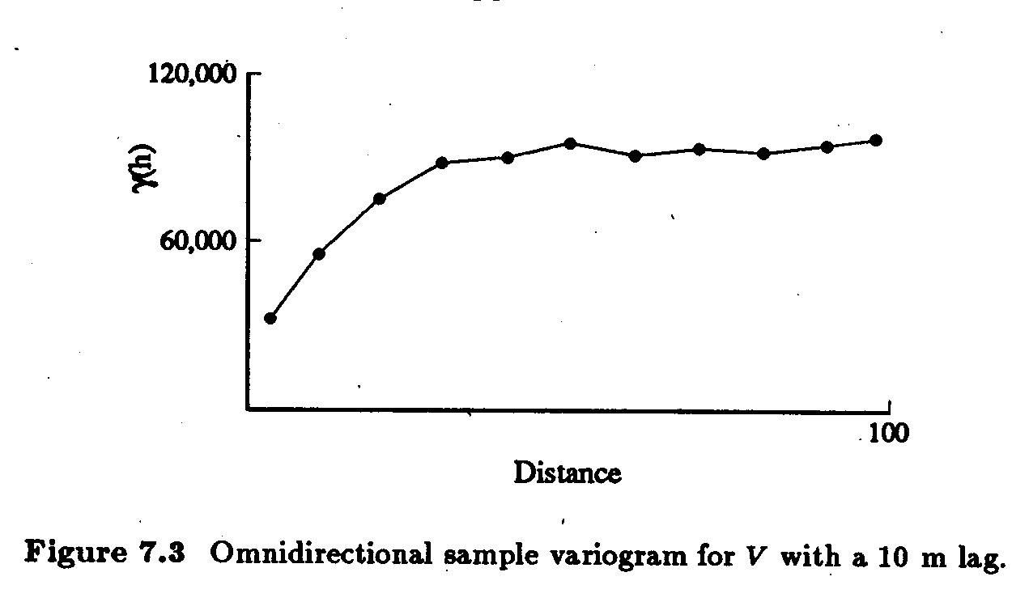
How to read the variogram
Example of variogram

Slide 28
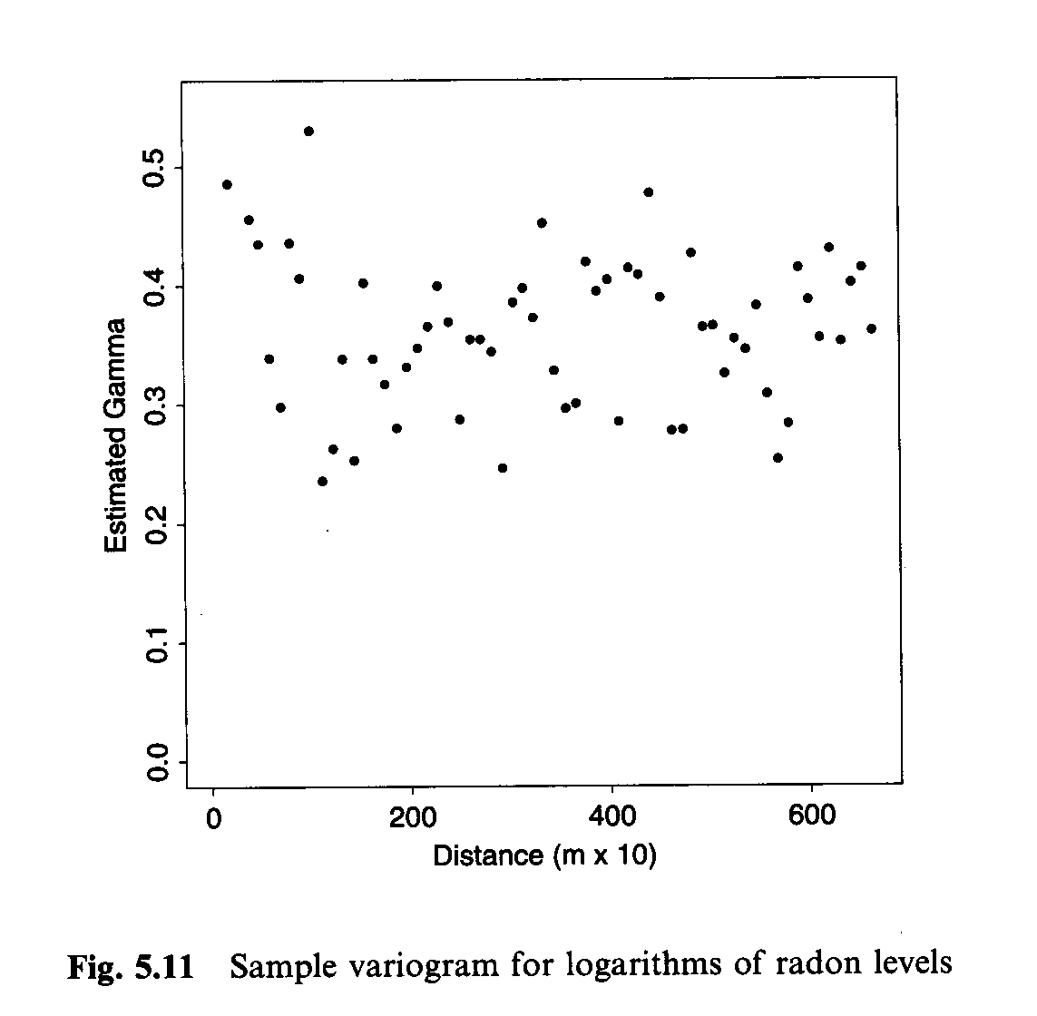
How to read the variogram

Slide 29
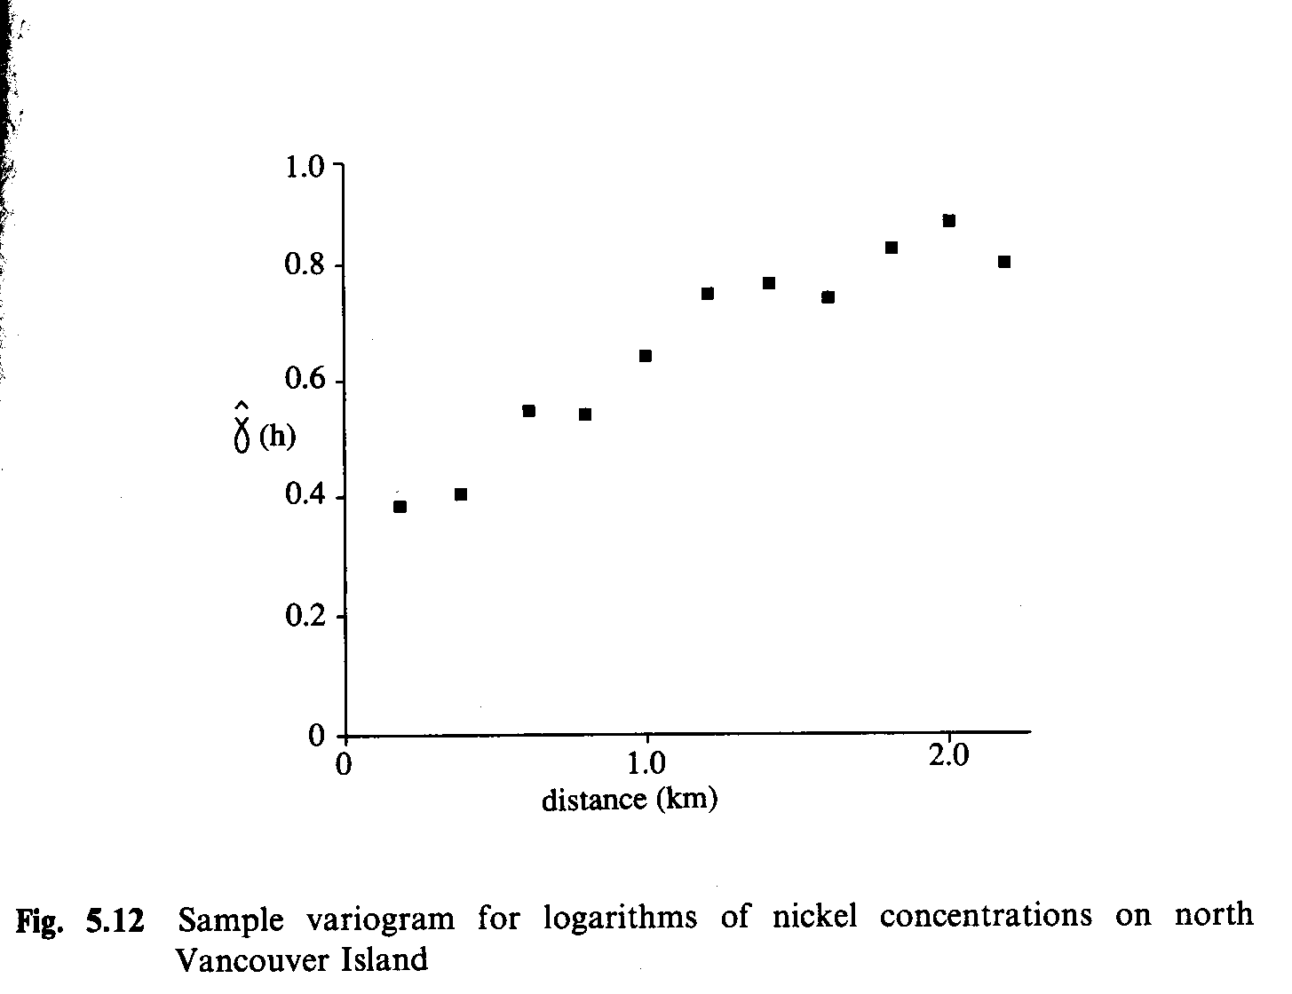
How to read the variogram

Slide 30
Some important issues
Selection of spatial lags h

Slide 31
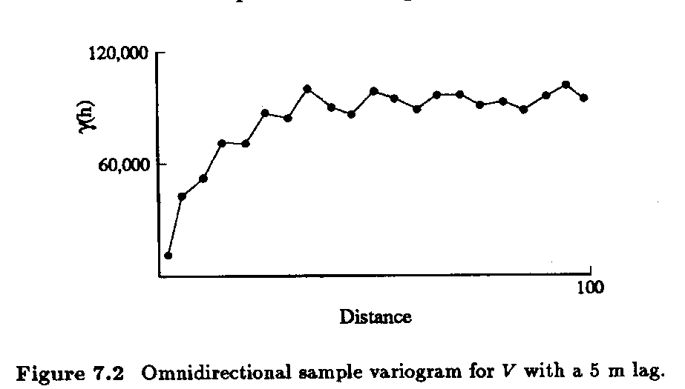
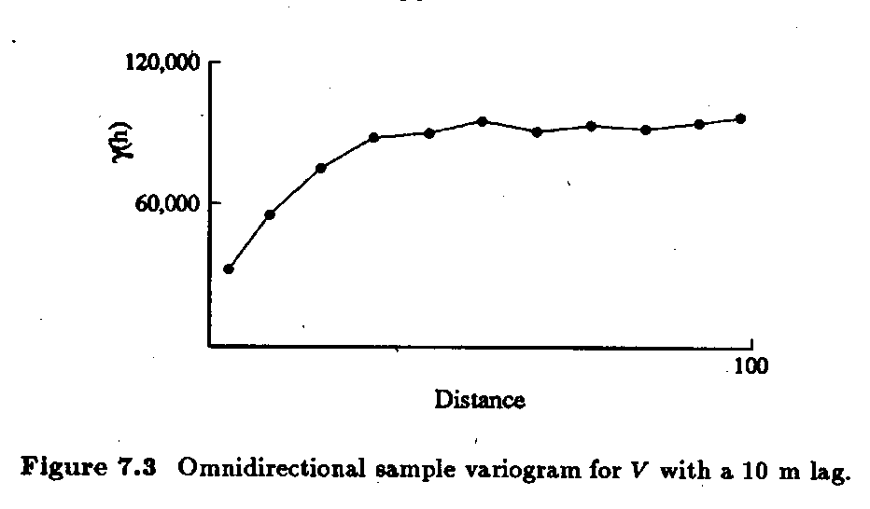
Some important issues
Selection of spatial lags h
  Number of point pairs
  Few points, low reliability

Slide 32

Some important issues
Selection of spatial lags h
  Number of point pairs
  Few points, low reliability
…
(4856)
(5140)
(3044)
(178)

Slide 33


Some important issues
Selection of spatial lags h

Slide 34
Some Important Issues: Isotropy
The process depends only on distance, not direction
  Useful preliminary assumption
    Omnidirectional variogram
    Cleaner relationships
  Must be checked against the data

Slide 35
Some important issues
Anisotropy
  Isaaks and Srivastava (1989) Applied Geostatistics, chapters 7 and 16

Slide 36
Anisotropy: Walker Lake

Slide 37
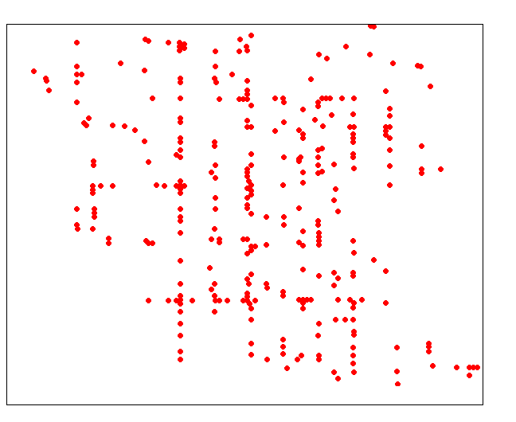
Anisotropy: Street Dust

Slide 38
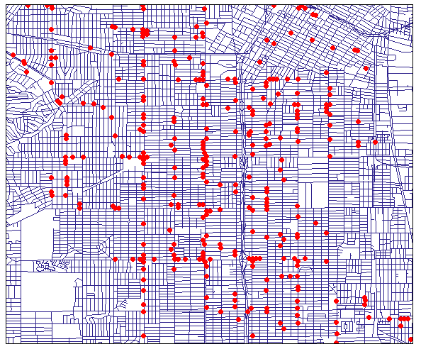
Anisotropy: Street Dust

Slide 39

Anisotropy
Directional variogram
  Selection of spatial lags h

Slide 40
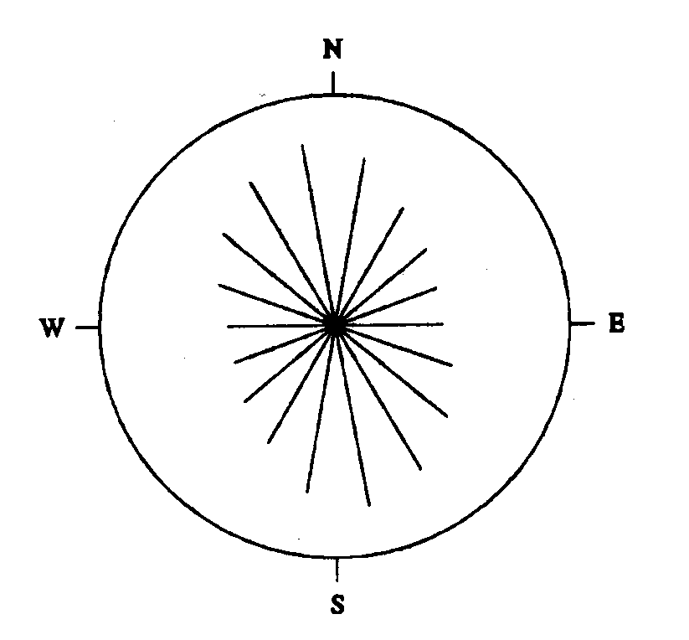
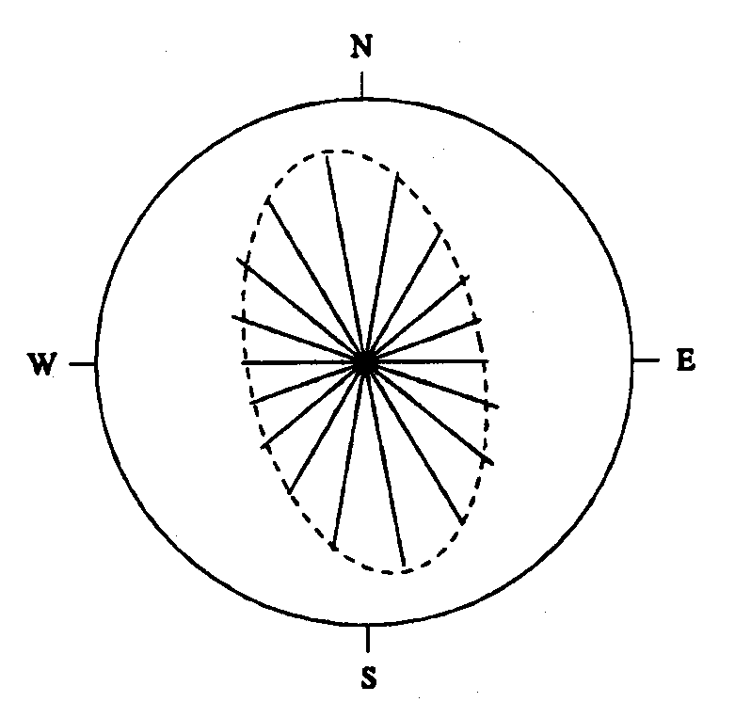
Directional Variograms
Walker Lake

Slide 41
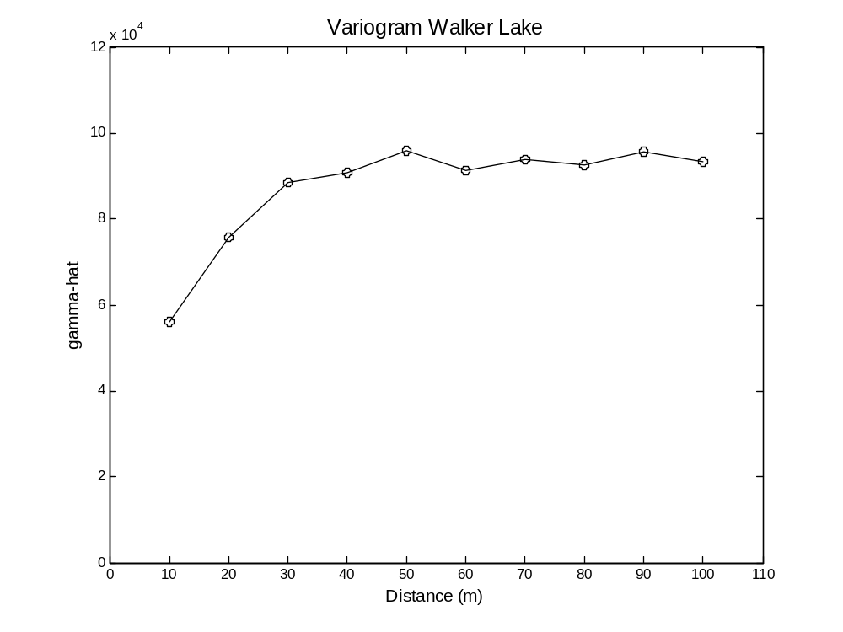
Describing Spatial Structure
Empirical Variogram

Slide 42
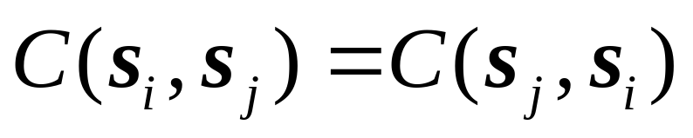
Variogram Models
A theoretical model that fits the empirical variogram
The variogram model should produce a covariance matrix that is:
  Symmetric
  Non-negative definite

Slide 43
Variogram Models
Spherical
Exponential
Gaussian
Linear
Bessel
…

Slide 44
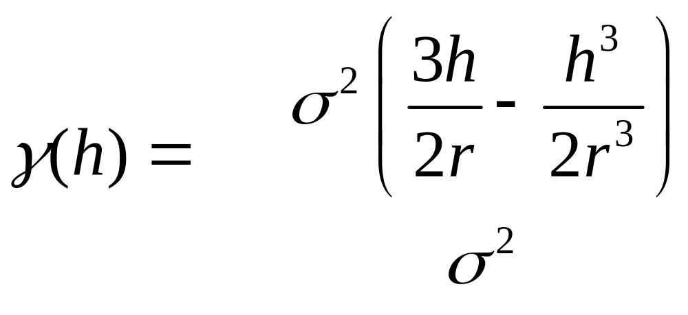
Variogram Models
Spherical
for h ≤ r
otherwise

Slide 45
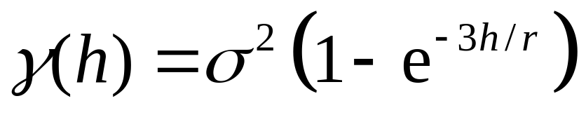
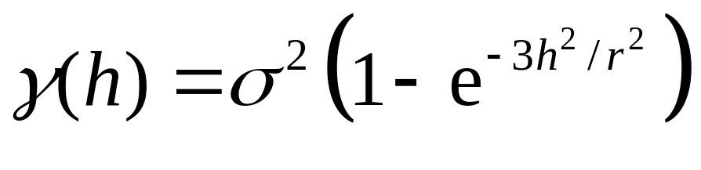
Variogram Models
Exponential
Gaussian

Slide 46
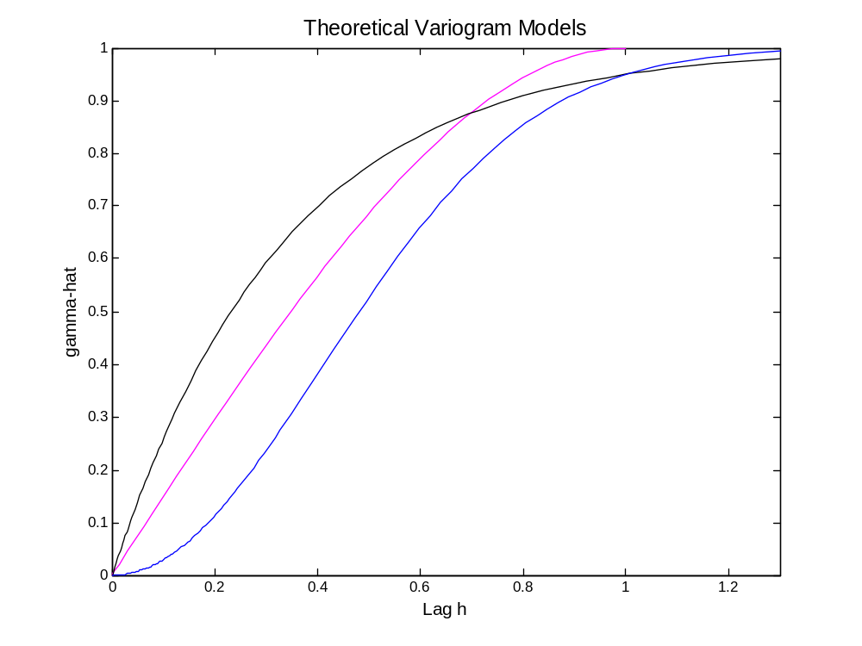
Variogram Models
Exponential
Spherical
Gaussian

Slide 47
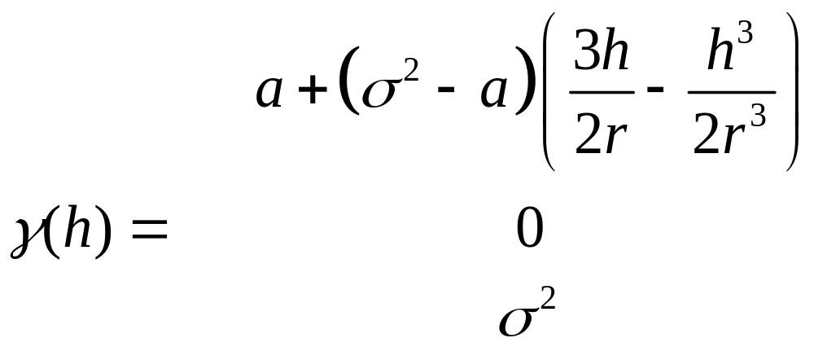
Variogram Models
Spherical with nugget effect
for 0 < h ≤ r
for h = 0
otherwise

Slide 48
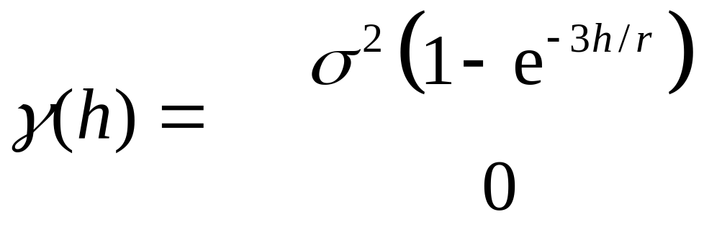
Variogram Models
Exponential with nugget effect
for h > 0
for h = 0

Slide 49
Variogram Models
Relative nugget effect
  The ratio of the nugget to the sill (a/σ²)
  Sometimes expressed as percentage
  A relative nugget of 100% indicates total absence of spatial autocorrelation

Slide 50
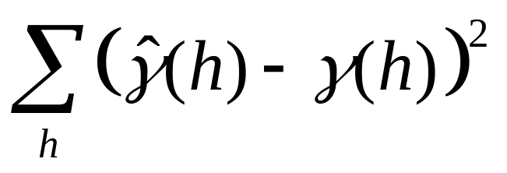
Variogram Models
Fitting a theoretical model: Least squares
h

Slide 51
Second Order Effects
The covariogram, correlogram and variogram and exploratory tools to study second order properties of spatially continuous data
The variogram is more resistant to departures from the assumptions
These tools are important elements in modeling spatially continuous data

Slide 52
First AND/OR Second Order Effects
Variogram analysis very effective in the presence of pure second order effects
Effect of a trend on variogram analysis
De-trending the data
Trend surface analysis

Slide 53
Modeling Spatially Continuous Data
Trend Surface Analysis
  A method to model the first order component of a spatial process
  Multiple regression analysis using the coordinates of the points as “explanatory” variables

Slide 54
Multiple Regression Analysis
Y
b₂
X₂
b₁
a
X₁

Slide 55
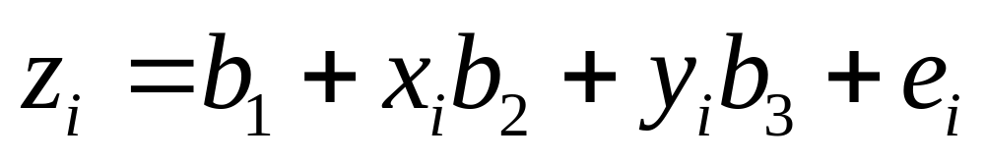
Trend Surface Analysis
Linear trend surface
  z: dependent variable
  b₁ , b₂ , b₃: regression parameters
  x , y: coordinates of point i

Slide 56
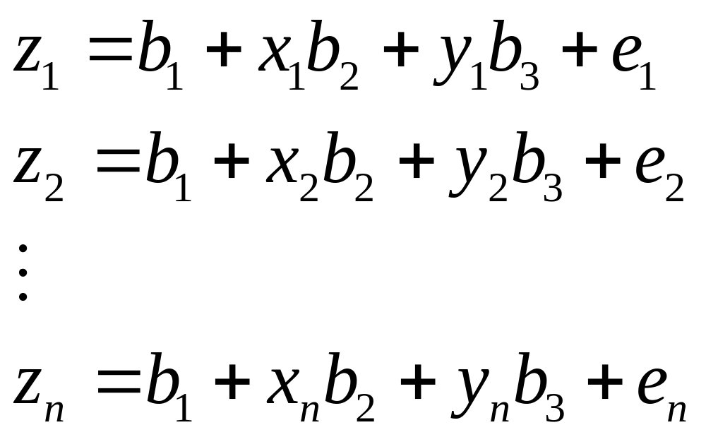
Regression Analysis: Matrix Notation
Linear trend surface

Slide 57
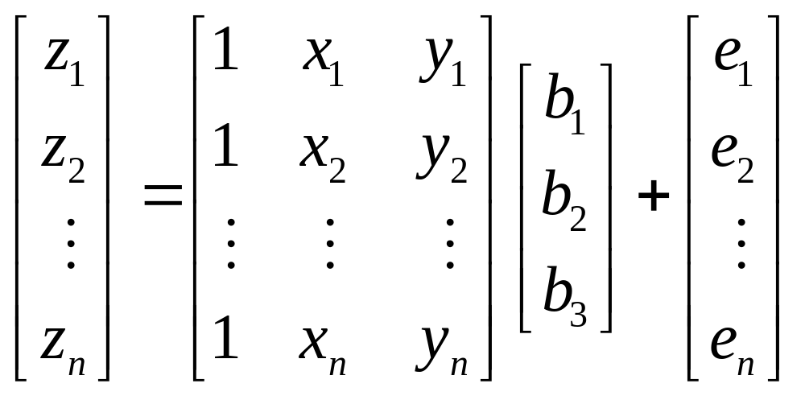
Regression Analysis: Matrix Notation
Linear trend surface

Slide 58
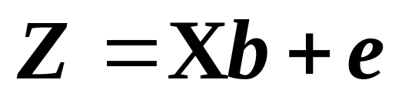
Regression Analysis: Matrix Notation
Linear trend surface

Slide 59
Regression Analysis: Assumptions
Error terms

Slide 60
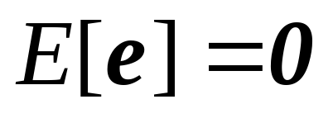
Regression Analysis: Assumptions
Error terms
  Expected (mean) value = 0

Slide 61
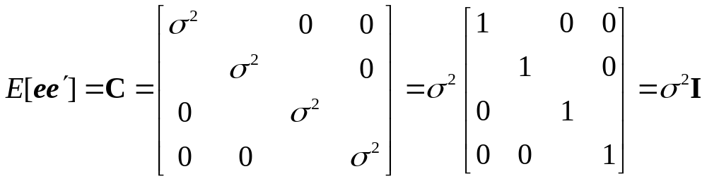
Regression Analysis: Assumptions
Error terms
  Constant variance
  Independent

Slide 62
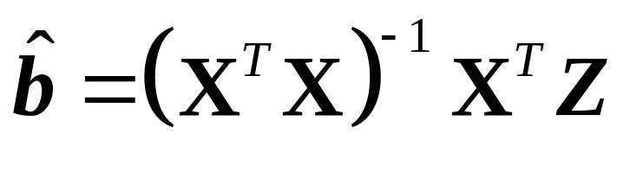
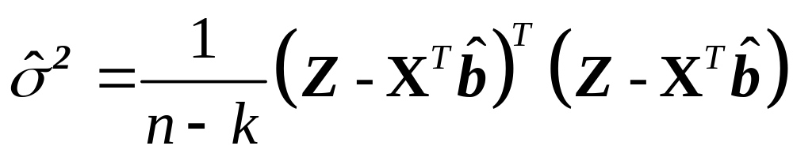
Regression Analysis: Estimation
Parameters
Variance

Slide 63
Next…
Spatially continuous data V-VI
  Spatial prediction
  Kriging

